Slide 1
Secure Sharing of Partially Homomorphic Data
Hossein Shafagh, Anwar Hithnawi, Lukas Burkhalter, Pascal Fischli, Simon Duquennoy
ETH Zurich, Switzerland
France and RISE SICS, Sweden
Presented by: Chenxing Ji

Slide 2
Securing Sensitive Data in the Cloud
IoT devices often utilize cloud to store and provide ubiquitous access to collected data
Many IoT applications involving Health application contains sensitive data

Slide 3
Homomorphic Encryption
Allows computation on Encrypted Data
Example:
Encrypted(A) + Encrypted(B)=> Encrypted(A+B)
Decrypt(Encrypted(A+B)) => A+B
Can be used to securely chain different services without exposing raw sensitive data
Has weaker security properties than non-homomorphic encryption
Definition: A form of Encryption that allows computation on ciphertexts, generating an encrypted result which, when decrypted, matches the result of operations as if they had been performed on plaintext.

Slide 4
Homomorphic Encryption Applications
Calculate: Tax, Currency Exchange Rate
Shipping on transaction without exposing unencrypted data
Create secure system: Secure voting system, Collision-resistant hash functions, and private information retrieval schemes

Slide 5
Partially Homomorphic Encryption
Partially Homomorphic Encryption:
Supports either addition or multiplication
Fully Homomorphic Encryption:
Supports both addition and multiplication

Slide 6
Current PHE approaches
Support either one of the following:
Encrypted Query Process
Secure Sharing
But not both

Slide 7
Threat Model
Clouds are honest-but curious
Adversary might be eager to learn about user data
External adversaries could gain access to encrypted data
In all: System compromise, financial incentives, malicious insiders

Slide 8
Assumptions:
IDP (identity providers) correctly verifies users’ identity.
Group members of shared data are semi-trusted.
External adversaries could gain access to encrypted data.
Application behave correctly.
Party member communicate through secure channel.

Slide 9
Pilatus: Data Protection Platform
Construct a sharing revocation mechanism
Improve decryption time
Also present two case study apps running Pilatus
Specifically Tailored for IoT Scenarios
Demonstrated PHE on embedded systems

Slide 10
Pilatus Design Approach
Used a re-encryption scheme – Data encrypted at Client
Key revocation mechanism – Allows user to terminate their sharing any time
Challenge:
Minimize the decryption time
Solution:
Chinese Remainder Theorem

Slide 11
Partially Homomorphic Encryption
Allows integer m to be mapped to an EC point M and be remapped to m.
Use Chinese Remainder Theorem along with BSGS (Baby-Step-Giant-Step) algorithm to solve discrete logarithm problem
Equations:
ENC(m1) o ENC(m2) = ENC(m1+ m2)
M = mG

Slide 12
Re-Encryption
Standard Mode:
Uses EC-Elgamal:
a asymmetric key encryption algorithm
Data Sharing:
AFGH:
A Improved Proxy Re-Encryption algorithm
AFGH reference: https://eprint.iacr.org/2005/028.pdf

Slide 13
Performance Optimization
For example, the 15s decryption time for a 38-bit value is reduced to less than 10ms for EC-ElGamal
Chinese Remainder Theorem
Maintain additive homomorphism
Side effect: Increased Encryption cost and Ciphertext size

Slide 14
Key Update
The method is triggered when a user decided to revoke a shared data
User use the new key for encrypting new data
Two cases for key update:
Malicious cloud Not that safe
Better leave the old data with old key
Semi-honest cloud Safe
Encrypt old data with new key for consistency
Pilatus requires a semi-honest cloud

Slide 15
Group Sharing Authorization
Access Graphs:
Each group have an access map
Members acts as node in the graph, each node is signed by the parent.
Allows group members to vouch for the membership of other members
Joining: Two steps
Signing the extended identity
Issuing a re-encryption Token stored in Cloud

Slide 16
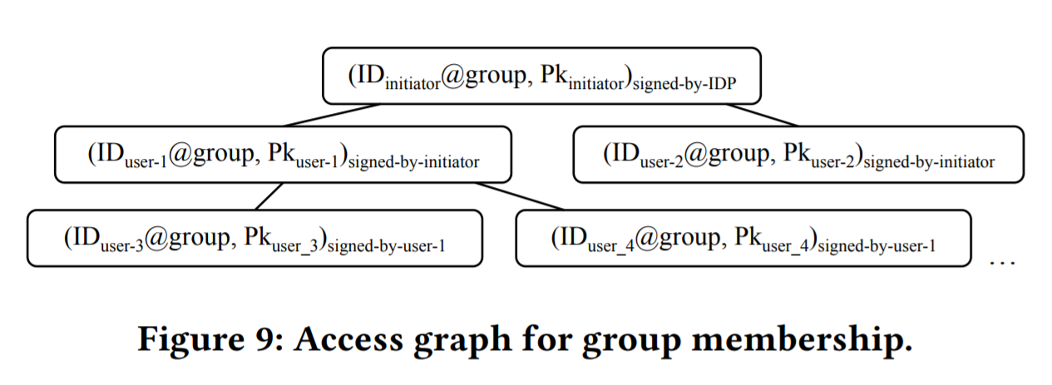
Group Authorization Graph Explanation

Slide 17
Security Analysis
Goal: Defying passive attacks and prevent unauthorized access to data in cloud
Achieves:
Data on the cloud remains strongly encrypted
Rely on IDP to authenticate users
Restrict data access to users with decryption keys
Prevent malicious cloud from performing unauthorized re-encryption to a malicious user

Slide 18
Implementation
Utilize EEC module of OpenSSL Library
Data sharing components based on RELIC toolkit
MySQL database cloud engine with User Defined Functions
Prototype Android Application Fitbit and Ava

Slide 19
Evaluation key data
Computational time:
CPU time required for the operation
Ciphertext size:
Impact on communication channel
System Throughput:
Operation rate on the cloud
Application Latency:
Time from client initiate the connection to receiving and decryption results.

Slide 20
System Evaluation
On smartphone, the design used batch encryption/decryption with multithreading that yields a 3x performance improvement

Slide 21
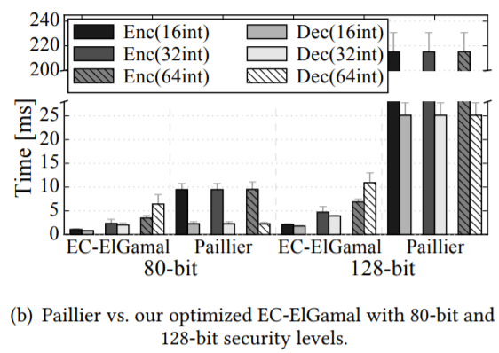
System Comparison

Slide 22
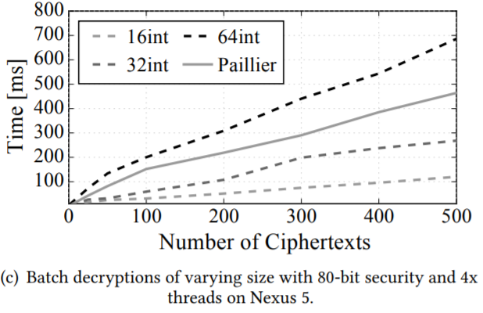
System Comparison Continued

Slide 23
Test Methodology
Uniformly random three input size: 16, 32 and 64-bit integers
Each experiment at least 1000 times
For key generation option, repeated 100 times
Use Google Guava Stopwatch class for time measurements

Slide 24
Performance
The paper selected two and three congruences for 32-bit with respect to 64-bit value as a tradeoff between ciphertext expansion and encryption/decryption times.
Note: The performance gains of CRT plateau and a higher number of congruencies do not yield further gains.

Slide 25
Memory Usage
Pilatus requires two separate look-up tables: standard and data sharing
With 80-bit security
The standard hash map accounts for 67Mbytes
The data sharing hash map accounts for 69Mbytes
The tables are shared among all the Pilatus applications

Slide 26
System Benchmark
Evaluates Pilatus as a full system:
Throughput
End-to-end latency
Two case study application
Methodology
Use Amazon Cloud Service as the cloud

Slide 27
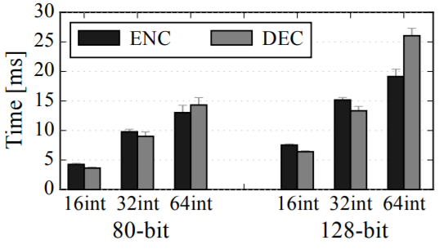
Ciphertext size and ENC/DNC in Data sharing

Slide 28
Tokens and APPLICATION PERFORMANCE

Slide 29
Cloud Throughput and LATENCY
Cloud Engine running on Amazon with 80-bit security.

Slide 30
Conclusion
Pilatus:
Users have full control over their data
Cloud only has access to encrypted data
Process queries on encrypted data and re-encrypt for sharing
Cryptographically guarantees and possibility of revocation
Optimized cryptographic operation

